Slide 1
“Entrepreneurship, Innovation, and Public Policy: Evidence from Major U.S. Cities”
Scott W. Hegerty, Ph.D.
World Economy Research Institute
October 19, 2023

Slide 2
Major issues
How do “cities” grow and attract entrepreneurs?
What are the economic effects of increased entrepreneurship?
How can this be measured?
How do relationships vary between cities?

Slide 3
Trends in U.S. cities
U.S. Industrial Transformation:
Manufacturing → Services → Producer Services
Demographics:
Suburbanization (decreasing share of core-city population) Migration from “Rust Belt” to “Sunbelt”
Remote work: revival based on costs?

Slide 4
Monolithic vs. Diverse cities
Detroit (in the automobile heyday)
Chicago (today)
San Francisco (over time; vs. L.A.)
Tolerance for “failure”?
Mechanism: Entrepreneurship→ Growth
Diversification/knowledge spillovers/input markets

Slide 5
Literature
Krugman (1991): Increasing RTS
Barro and Sala-i-Martin (1991): Regional convergence
Armington and Acs (2002): firm birth rates: related to industrial density, population and income growth
Glaeser et al. (2010): “Entrepreneurial people” (not cost-related)

Slide 6
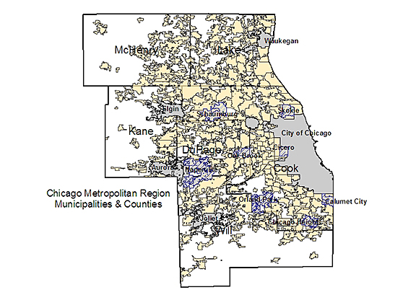
Public policy
Within the city proper Rebuilding population in the “new” economy “Creative class” (R. Florida)
Within metro areas Fragmentation and cooperation: Chicago as an example Impact on inequality
Between metro areas (and states!) Convergence vs. divergence? Explaining variation (while controlling for everything else)

Slide 7
An Empirical Study
Measure entrepreneurship for large U.S. Metropolitan Statistical Areas
Preliminary analysis: Connections to poverty (including < age 18), inequality, income
Extensions: Different size thresholds, multivariate model

Slide 8
Two measures:
107 MSAs with population > 500K
1) Small-firm job creation 2016-2020 (growth, %): njc1620
2) Average # of employees in small firms (as a share of the total): 2016, 2018, 2020: afjc3

Slide 9
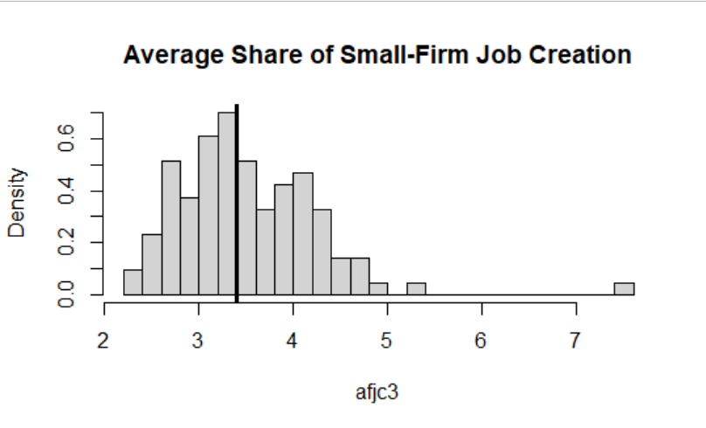

Slide 10
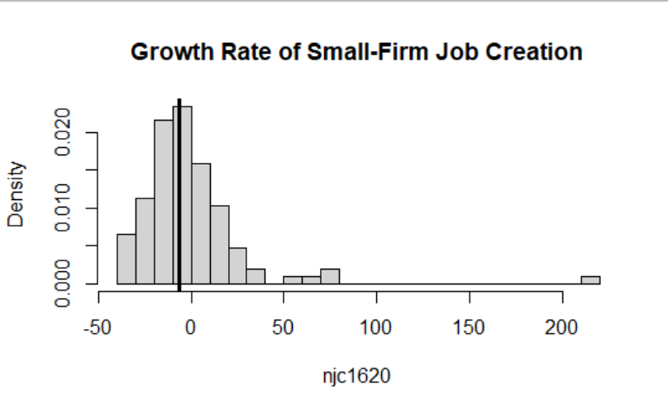

Slide 11
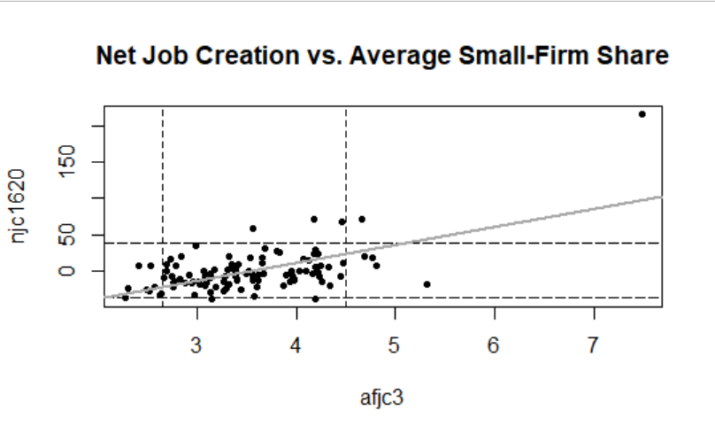
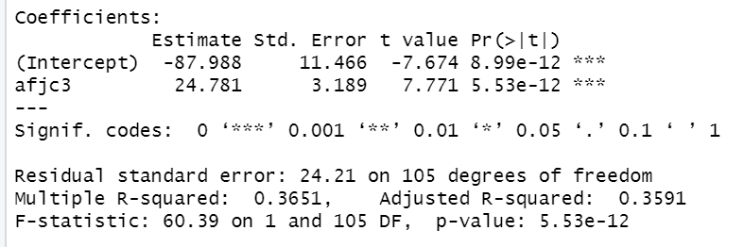
Evidence of Divergence?

Slide 12
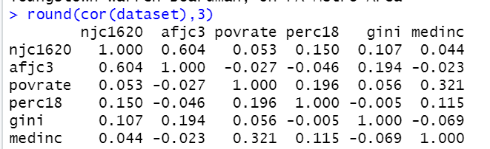
Correlations with demographics

Slide 13
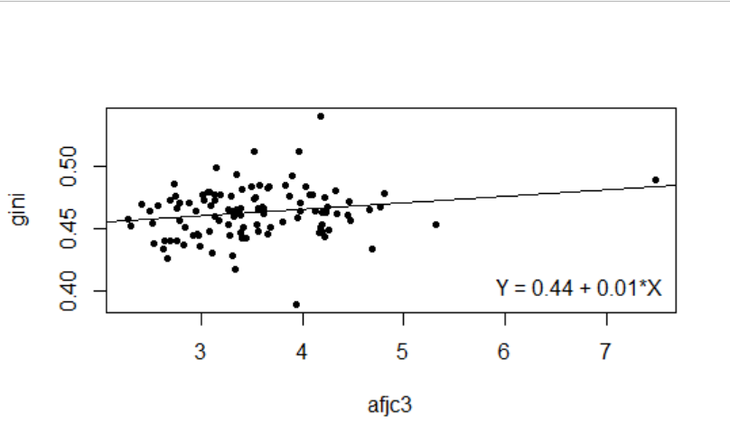
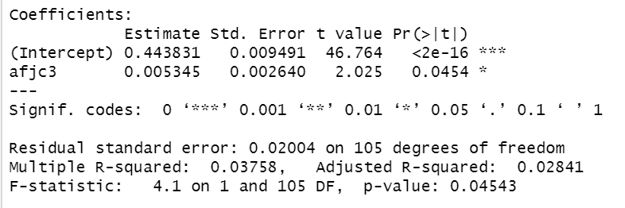
Entrepreneurship and Inequality

Slide 14
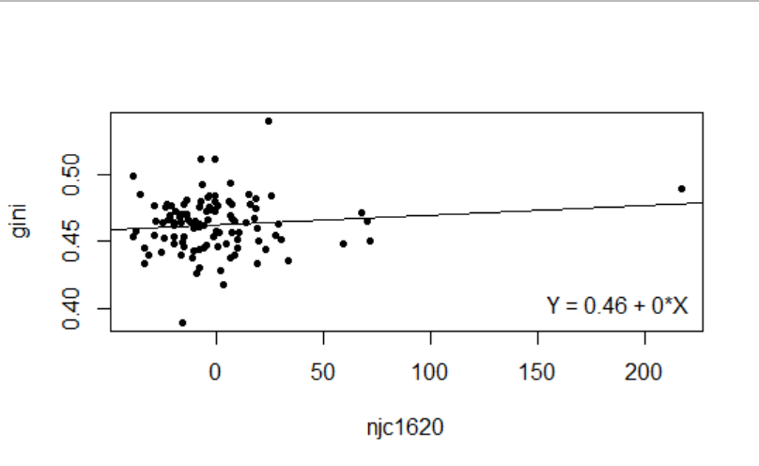
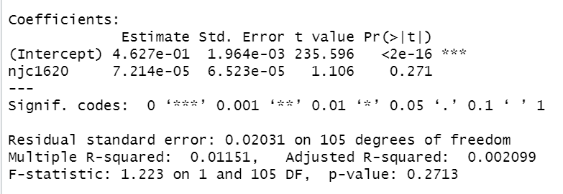

Slide 15
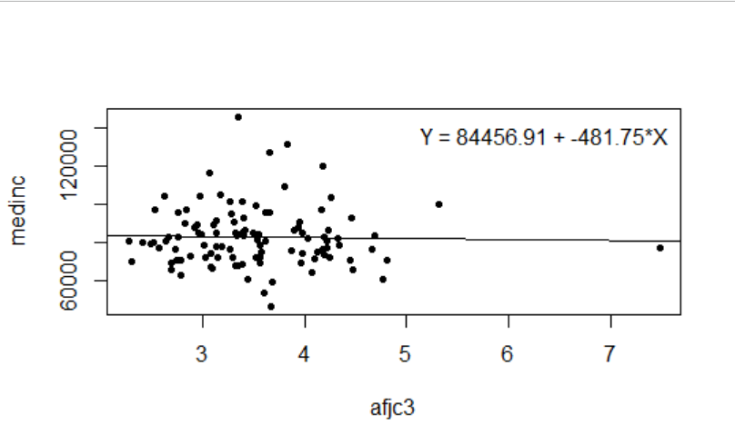
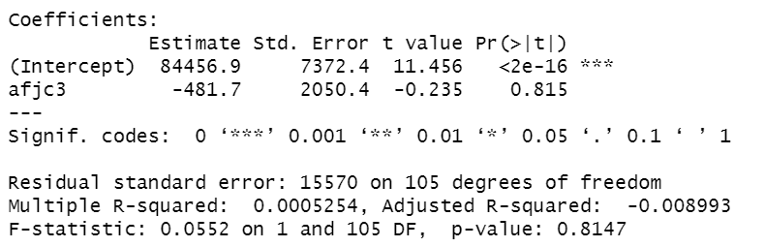
Entrepreneurship and Income

Slide 16
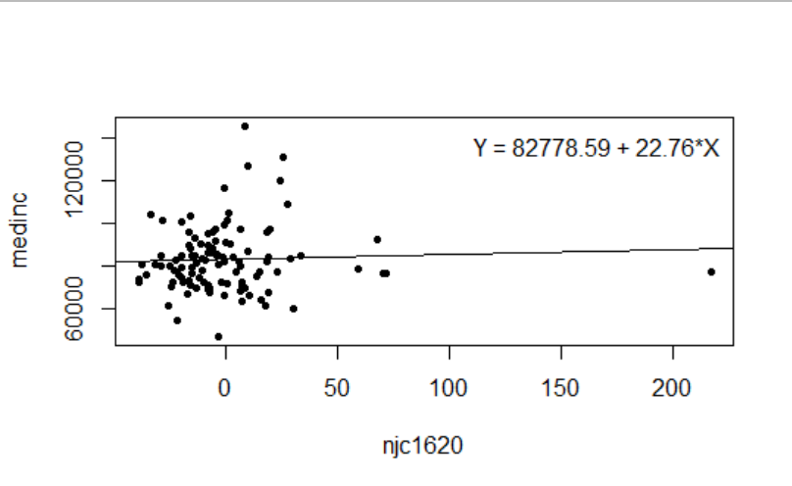
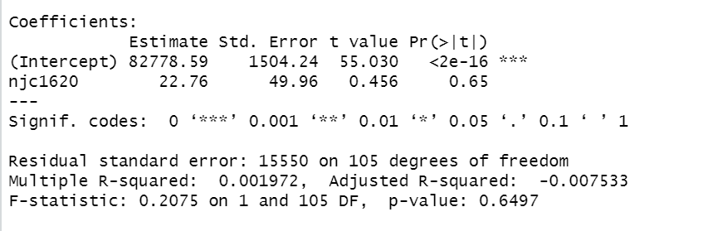

Slide 17
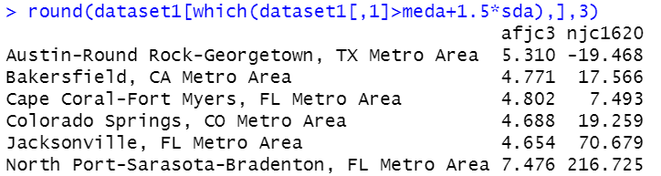
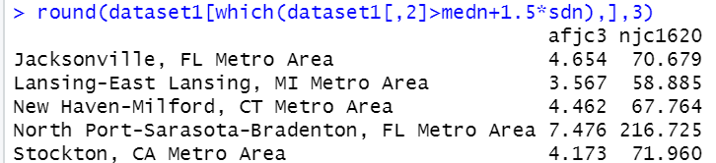
Leaders and laggards: +1.5σ > median

Slide 18
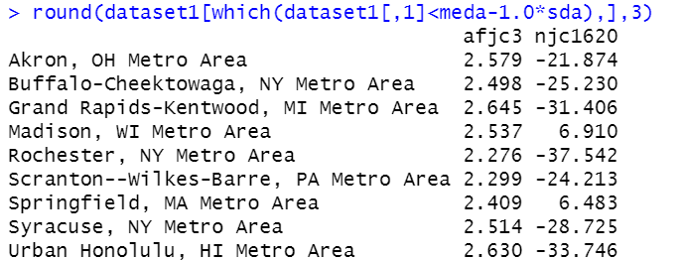
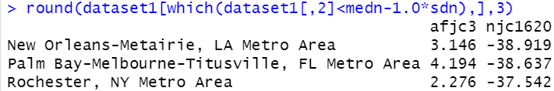
Leaders and laggards: +1.0σ < median

Slide 19
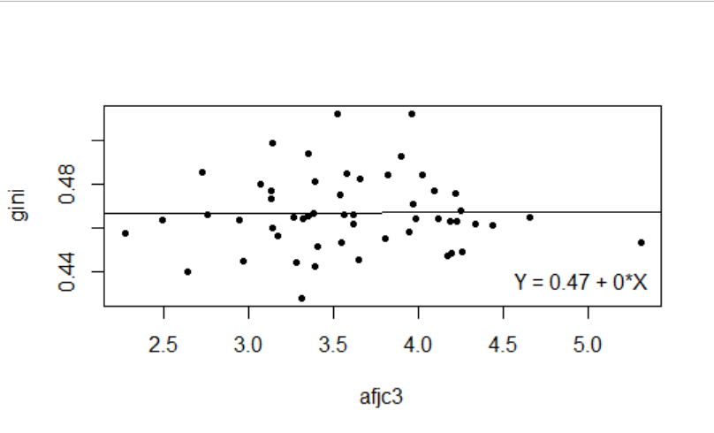
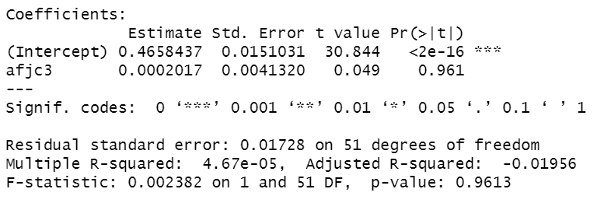
What if MSA pop >1,000,000? (N = 53)

Slide 20
A story of two metros
Rochester, NY: 332K (1950)→211K (2020)
Kodak, Xerox (but also Rochester Institute of Technology)
Jacksonville, FL 204K (1950) →950K (2020)
Fidelity, other financial services
National trends + state policy?

Slide 21
Future covariates
Pop. growth, income growth, education, industry type/density
Can capture between-metro variation
But need to control for various external factors

Slide 22
Conclusions/New Directions
Able to calculate two “entrepreneurship” variables
→Can compare against others in the literature
Classify high/low values→ Case studies
Growth increases with levels: Divergence?
Bivariate associations (little connection) → Formal model
Related to policies?

Slide 23
Thank you!
S-Hegerty@neiu.edu

